Slide 1
Study of Floating-point Verification
By Dietrich Geisler

Slide 2
Overview
Floating-Point Arithmetic (FPA) allows succinct bitwise representation of decimals in computing
However, FPA presents potentially serious flaws and bugs
There is a growing need to verify FPA
The objective of this project is to add FPA verification to Boogie

Slide 3
Floating Point Representation
Floating Points are represented by a sign, exponent, and mantissa
This is similar to scientific notation: e.g. 6.02x10² = 602
For example, 17 has an exponent of 4 and a mantissa of (1).0001
Now consider the FP representation of 1 / 10 (decimal 0.1)

Slide 4
IEEE 754 Standard
The standard Floating Point representation in 32-bit architecture contains the following:
1-bit sign
8-bit exponent
23-bit mantissa
This representation includes values for ∞, -∞, NaN, and -0

Slide 5
Rounding Error
No matter how good our approximation, the Archimedean principle implies there are an infinite number of real numbers that we cannot represent exactly
For Floating Points, average approximation improves as a value approaches 0

Slide 6
Floating-Point Addition
FP addition is performed by matching exponents and adding bits
Rounding error can occur due to mantissa size. Consider 2²⁴ + 1
Guard digits can be introduced to help negate this effect
The special case ∞ + (-∞) results in NaN

Slide 7
Floating-Point Multiplication
Multiplication is similar to addition
Note that the potential for rounding error and lost data is much greater with multiplication than addition
The operations 0 x ∞, 0 x - ∞, and any value n / 0 result in NaN

Slide 8
Issues With FPA
FPA is complete through the inclusion of ∞ and NaN
Overflow is a potential issue
The largest problem is, of course, rounding error
For example, (0.1 + 0.1 + 0.1) != 0.3 within the float representation

Slide 9
FPA in Z3
Uses the Conflict-Driven Clause Learning algorithm (CDCL)
Steps of this algorithm follow the general outline of the DPLL algorithm
For FPA evaluation in particular, the most significant change is providing the correct floating point constraints and definitions

Slide 10
Program Flow
C Code
SMACK
Boogie
Z3

Slide 11
Current Project Status
Z3 has had some floating point logic already implemented
Currently, the general floating point type is recognized by boogie
Boogie floating points do not yet have defined operations
Some examples:

Slide 12
Future Work
Boogie float types must be improved to recognize all IEEE FP operations
Boogie representation of floats will be expanded to include a general exponent and mantissa size
SMACK will be modified to recognize float types and convert them to boogie

Slide 13
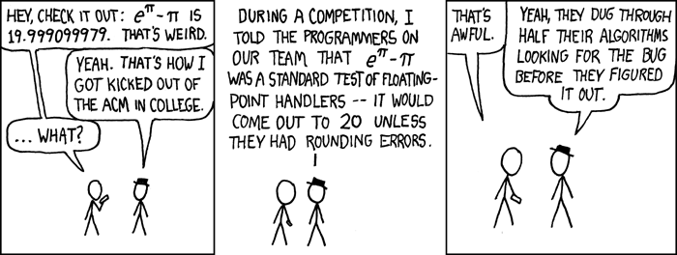
Conclusion/Questions
XKCD comic #217, xkcd.com/217/, credit Randall Munroe

Slide 14
References
What Every Computer Scientist Should Know About Floating-Point Arithmetic by Joe Darcy
Wikipedia article on floating-point arithmetic by several
Deciding floating-point logic with abstract conflict driven clause learning by several
This is Boogie 2 by K. Rustan; M. Leino

